Slide 1

Scientific Data Visualization Project
Impact of COVID-19 on Tech Industry: An Analysis of Google Stock Prices, Tech Layoffs, and Data Science Salaries
Team members
Hemanth Kumar Kakani (11655430)
Vaishali Konda (11614540)
Neeraj Reddy Aluka (11694856)
Sree Kohali Patel (11694857)

Slide 2
Introduction
Domain
The Project focuses on the impact of the COVID-19 pandemic on the tech industry, examining changes in Google's stock prices, tech job layoffs, and variations in data scientist salaries from 2019 to 2024. The project aims to investigate how these elements interrelate and affect economic trends within the tech sector. Advanced data visualization techniques and statistical models are employed to analyze and visualize the correlation between COVID-19 impacts and market dynamics. The goals include illustrating data fluctuations, assessing employment impacts, scrutinizing salary trends, and providing predictive insights on economic prospects​

Slide 3
Data Abstraction
Datasets: Below are the details of the three datasets taken -
Dataset 1: https://raw.githubusercontent.com/HemanthKakani1407/SDV_Project_Datasets/main/(Data1)data_science_salaries.csv
Types and attributes: job_title,experience_level,employment_type,work_models,work_year,employee_residence,salary,salary_currency,salary_in_usd,company_location,company_size
Number of records – 6600
This is a structured data set and the noise is negligible and can be ignored.

Slide 4
Data Abstraction
Dataset 2:
https://raw.githubusercontent.com/HemanthKakani1407/SDV_Project_Datasets/main/(Data2)stock_prices.csv
Types and attributes: Year, Avg
Number of records- 633
This is an unstructured data and needed to be clean, transformed and cleaned.
Cleaned Dataset link is given below-https://raw.githubusercontent.com/HemanthKakani1407/SDV_Project_Datasets/main/(Data2)Stock_prices_cleaned.csv

Slide 5
Data Abstraction
Dataset 3:
https://raw.githubusercontent.com/HemanthKakani1407/SDV_Project_Datasets/main/(Data3)layoffs.csv
Type and attributes - Year, Avg_laid_off
Number of records – 3569
This dataset is an unstructured data and has noise which may impact the result. So it was cleaned from noise.
Cleaned Dataset link is given below- https://raw.githubusercontent.com/HemanthKakani1407/SDV_Project_Datasets/main/(Data3)layoffs_cleaned.csv

Slide 6
Data Abstraction
For performing various visualizations, below combinations of datasets are used -
Visualization 1 (matplotlib) : Dataset 1 & Dataset 2
Visualization 2 (tableau) : Dataset 1 & Dataset 3
Visualization 3 (D3.js) : Dataset 2(cleaned) & Dataset 3(cleaned)

Slide 7

Task abstraction (Target)
Target: The primary target of this project is to analyze and understand the impacts of the COVID-19 pandemic on the tech industry, specifically focusing on Google's stock prices, tech job layoffs, and data scientist salaries in the year 2022.

Slide 8

Task Abstraction (Action)
Data Collection
Data Cleaning and Pre-processing
Data Analysis
Visualization
Interpretation and Reporting
Predictive Analysis

Slide 9
Workflow Diagram
Data Collection
Data Cleaning and Preprocessing
Data Analysis
Visualization
Interpretation and Reporting
Predictive Analysis

Slide 10
Explanation
Data Collection: This is the first step where data on stock prices, layoffs, and salaries is collected from various sources.
Data Cleaning and Preprocessing: Here, the data is cleaned to remove inconsistencies and prepared for analysis. This step ensures that the data fed into the analysis tools is of high quality and uniform format.
Data Analysis: At this stage, the cleaned data is analyzed using statistical methods to identify patterns or significant correlations between the pandemic and its effects on the tech industry.
Visualization: The results from the data analysis are then visualized using graphs, charts, and other visual tools to make the data easily understandable and consumable.
Interpretation and Reporting: The visualized data and analysis findings are interpreted to draw conclusions. A detailed report is prepared to present these findings, discussing the implications and potential reasons behind the observed trends.
Predictive Analysis: Finally, predictive models are built and applied to estimate future trends. This step is crucial for forecasting and helping stakeholders make informed decisions based on the project's findings.

Slide 11
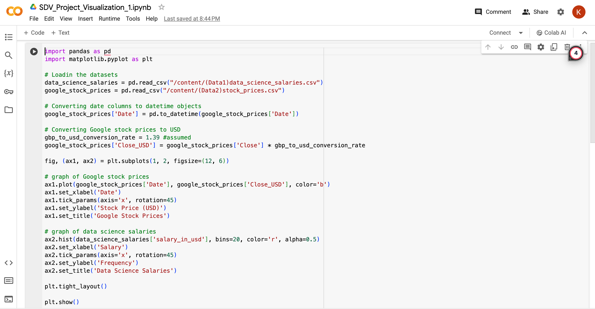
Implementation using tools
Matplotlib

Slide 12
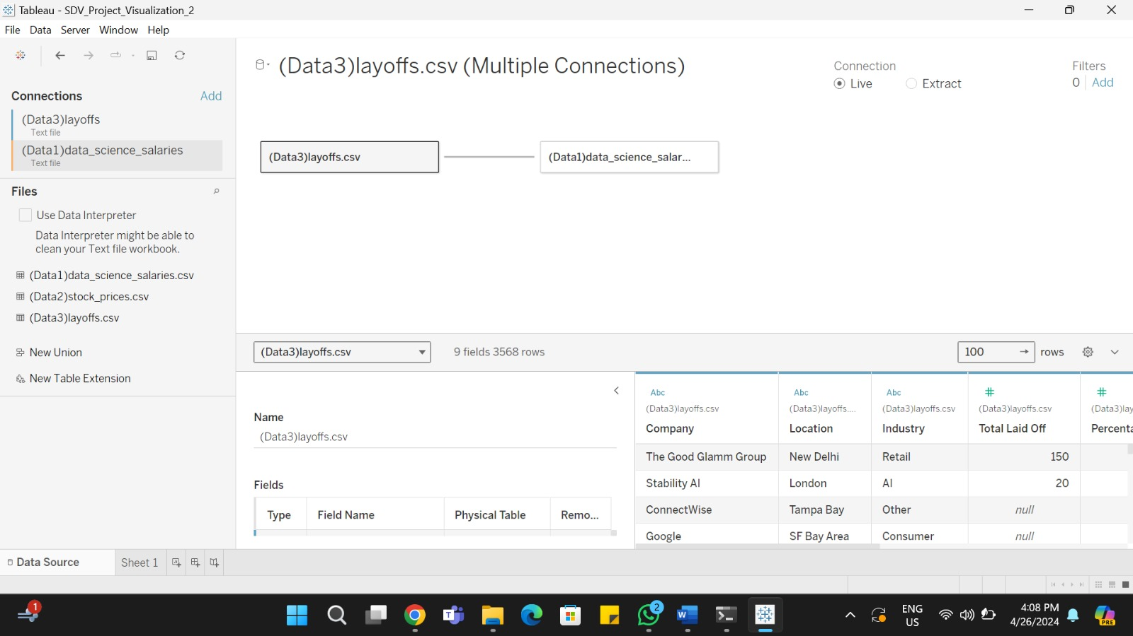
Implementation using tools
Tableau

Slide 13
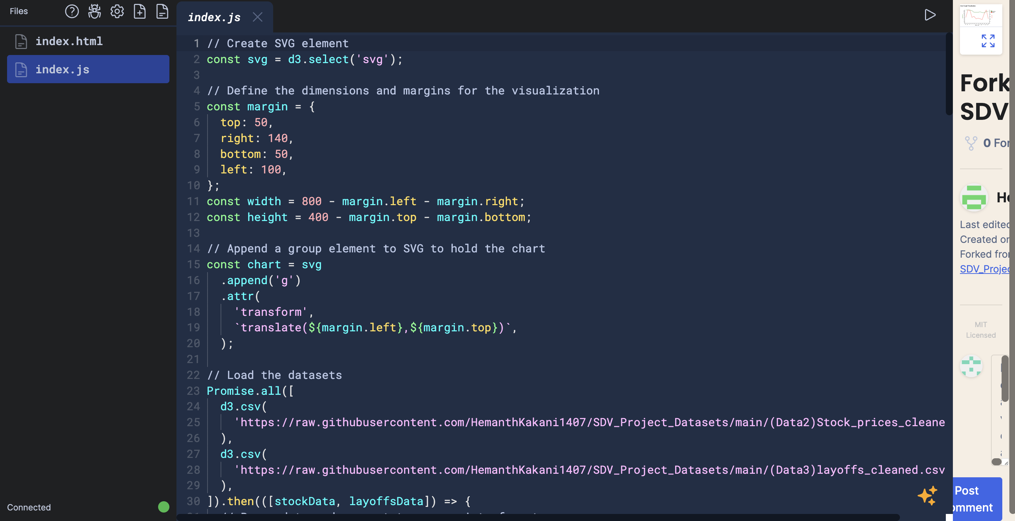
Implementation using tools
D3.js

Slide 14
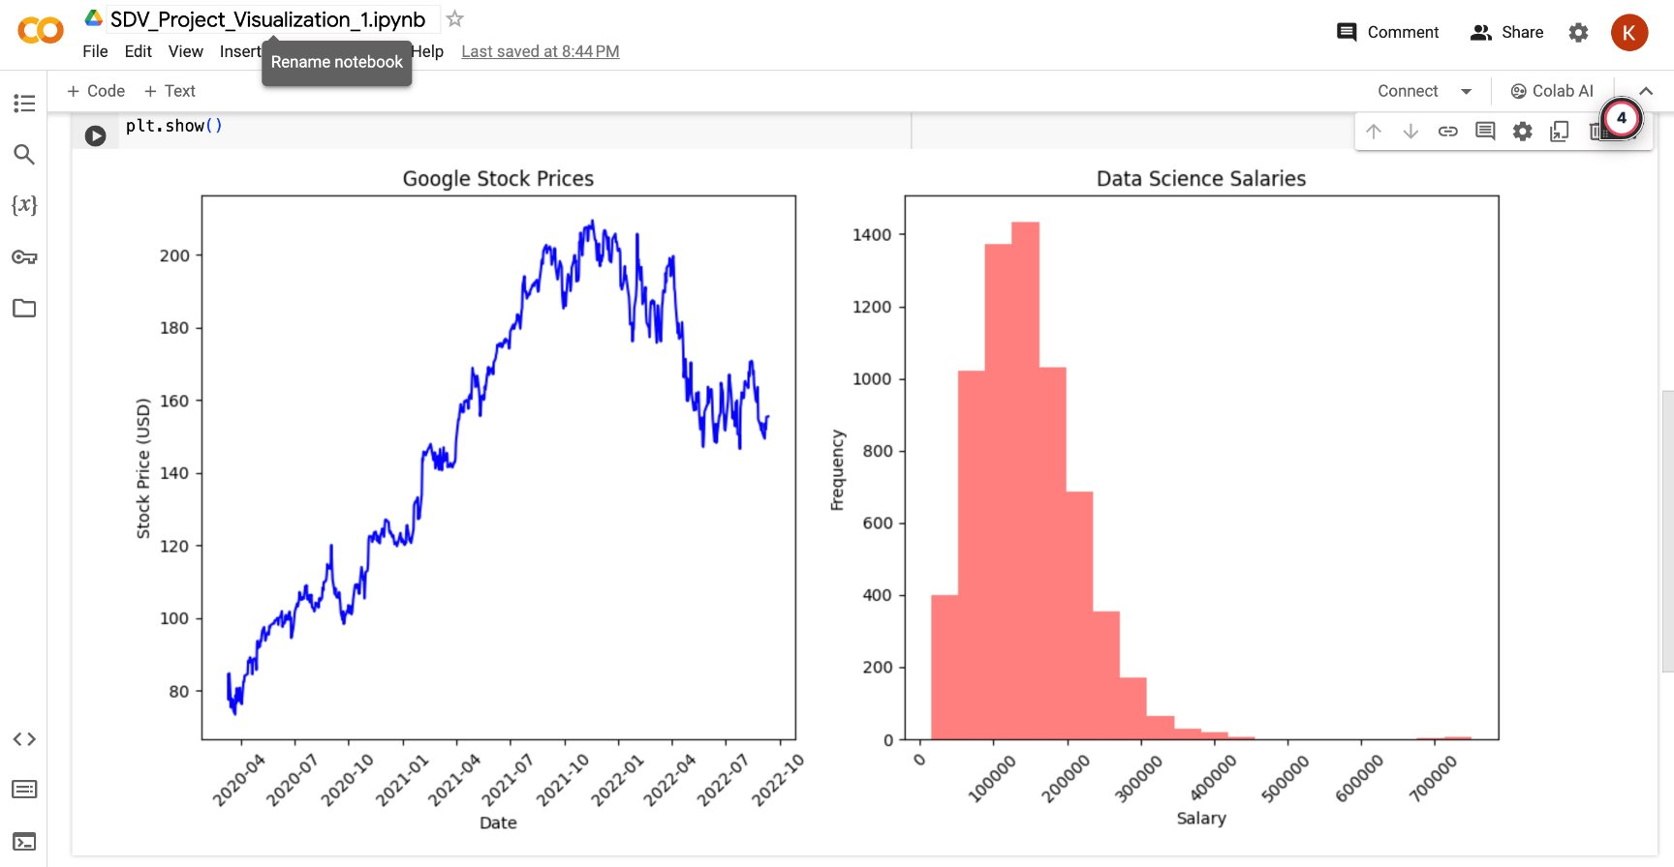
Result for Analysis
Matplotlib
This visualization represents the trends of Stock Prices and the salaries of data scientists. The bar graph shows the salaries and its frequencies(no.of data scientists drawing that salary) and the line graph represent the changes in the stock price in the years 2020, 2021 & 2022.

Slide 15
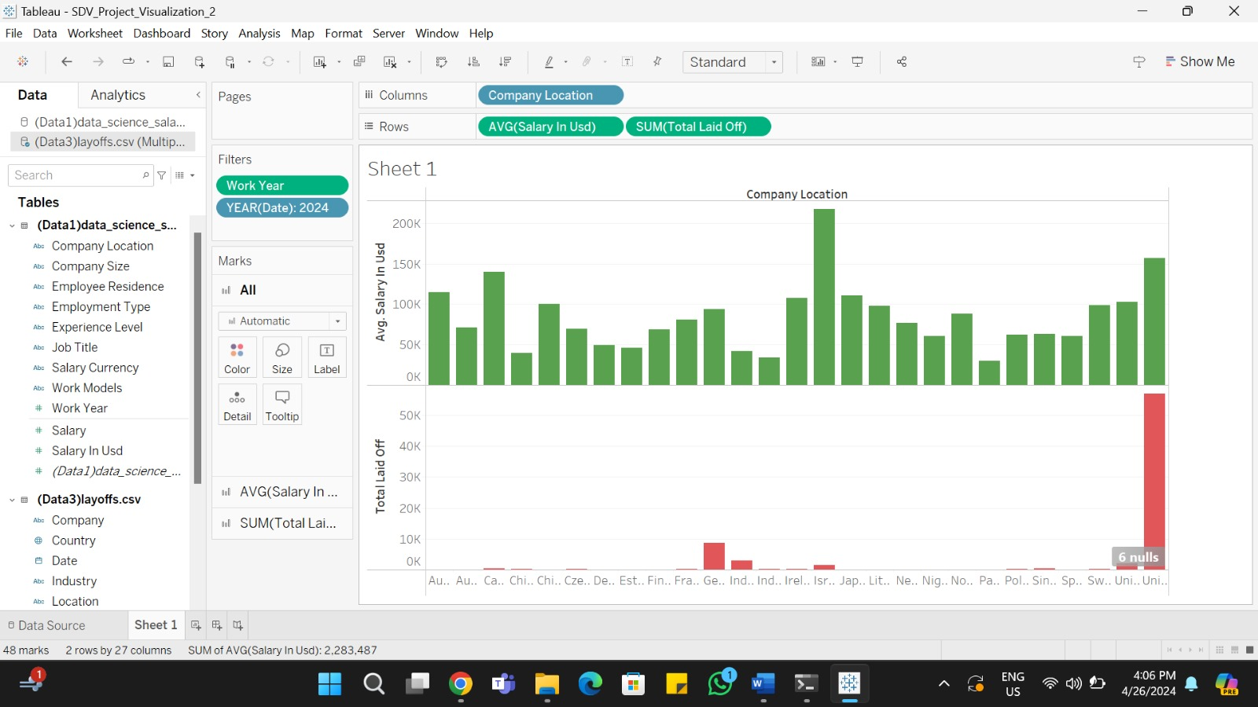
Result for Analysis
Tableau
This Bar graph represents the Salaries and Layoffs in the year 2024 across 10 different countries which are common in both the datasets. The red bars show the total number of layoffs and the green bars represent the average salaries of the data scientists.

Slide 16
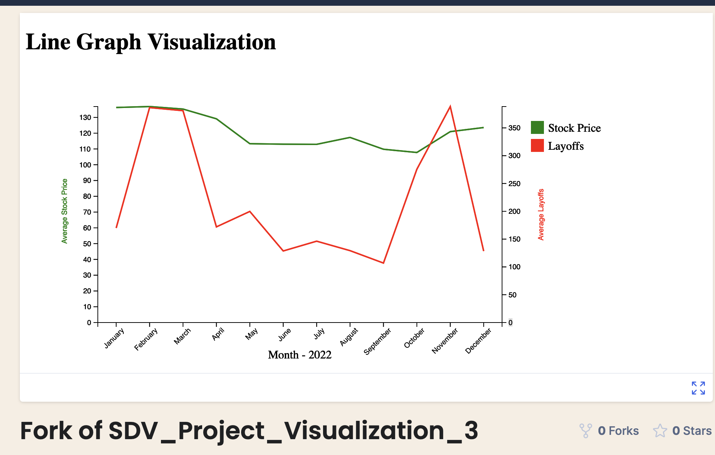
Result for Analysis
D3.js
https://vizhub.com/HemanthKakani1407/e9602144e7844697a57a1f2fb25441fe
This visualization represents the trends of Stock Prices and Layoffs in the year 2022. The red line shows the total number of layoffs and the green line represent the changes in the stock price through out the year.

Slide 17

Work Management
Implementation status report
work completed:
Description: We have divided the workload as below Responsibility:
Neeraj – Data collection
Hemanth – Data cleaning and preprocessing
Vaishali and Kohali – Data analysis, interpretation and Reporting
Visualization using matplotlib – Neeraj
Visualization using Tableau – Hemanth
Visualization using dj3.js - Vaishali and Kohali
Contributions: Out of 100 percent, below are the percentages of contribution -
Hemanth - 25
Neeraj - 25
Vaishali - 25
Kohali - 25

Slide 18
References
Google Stock Prices Since COVID-19 Started: This dataset will include the stock prices of Google since the pandemic began, allowing for an analysis of market reactions to the pandemic's developments.
https://www.kaggle.com/datasets/anubhavgoyal10/google-stock-prices-since-the-pandemic-started
Layoffs Dataset: A dataset covering tech layoffs from COVID-2019 to present, providing insights into how the tech industry's employment patterns have been affected.
https://www.kaggle.com/datasets/swaptr/layoffs-2022
Data Science Salaries 2024: Trends in the salaries of data science professionals from 2020 to 2024, offering a view into how the field has evolved in terms of compensation amidst the pandemic.
https://www.kaggle.com/datasets/sazidthe1/data-science-salaries
Fasanya, I. O., Periola, O., & Adetokunbo, A. (2022). On the effects of Covid-19 pandemic on stock prices: an imminent global threat. Quality & Quantity, 57(3), 2231–2248. https://doi.org/10.1007/s11135-022-01455-0
Business Toys. (n.d.). How has demand data science changed after covid? | Business Toy. https://businesstoys.in/blog/how-has-demand-data-science-changed-after-covid/
How the Coronavirus Affects Stock Prices and Growth Expectations. (n.d.). The University of Chicago Booth School of Business. https://www.chicagobooth.edu/review/how-coronavirus-affects-stock-prices-and-growth-expectations
Medium. (n.d.). Medium. https://data-storyteller.medium.com/data-science-project-tutorial-exploring-analytics-data-science-salary-data-23ee3b9b7de12

